Slide 1
How do you achieve a century-long life?

Slide 2
The purpose of this study
Explore if people express interest in the topic of longevity.
Finding what causes people to live longer than others on average?
What factors prevent living a century?
Discovered factors.
What is the purpose of living a long life?
What can be done to improve life longevity?

Slide 3
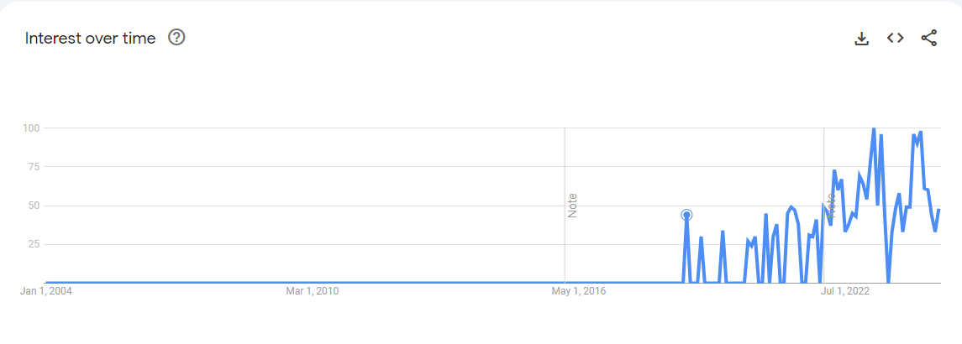
People’s interest in the subject of longevity?
People expressed little interest in the subject over the last twenty years, according to Google Trends.
The majority interest was expressed in Western and South Asian countries.

Slide 4

Factors that make people live longer.
Healthy diet mixed with fruits and vegetables.
Mild exercise.
Breathe fresh, clean air.
The air quality in a big city is more polluted, and it would be very hard to live up to 100 years while breathing unhealthy, polluted air.
Minimize stress level.
Live near nature or in smaller cities where the air is cleaner.
The majority of centenarians live in small cities or towns and breathe relatively fresh air.

Slide 5

Factors prevent living longer.
Smoking
A quick search on Wikipedia shows that as of 2007, smoking in Cuba accounted for 45% of the population, and in the Dominican Republic, as of 2019 stands at 11%.
High consumption of alcohol
Pollution
Deficit of necessary nutrients in some locations
It was discovered that people in the Chukotka Region, Russian Federation, lock necessary nutrients.
Stress

Slide 6
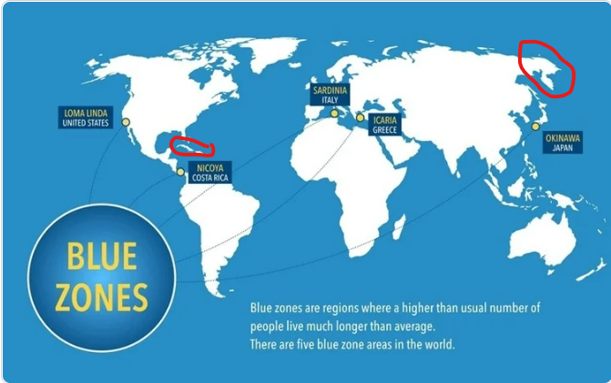
Discovered Factors
There are only five locations in the world called blue zones where the population of long-lived people is the highest.
All five locations are located near the sea or ocean. These are Loma Lima, USA; Nicoya, Costa Rica; Sardinia, Italy; Icaria, Greece; and Okinawa, Japan;
Many regions worldwide lock all necessary factors that prolong human life.
Life longevity can only be achieved by combining all good and healthy factors.
Healthy and bad habits mixed together cannot prolong life.

Slide 7

Why live long?
You can accomplish more in life.
You can be a good example to others and help to improve society.
Living long improves your family’s lives by being together.

Slide 8

How to prolong longevity?
Move to a better location where pollution is low and, possibly, near the ocean, sea, or mountains.
Quit Smoking!
Exercise more.
Eat healthy food.

Slide 9

Don’t give up!

